Slide 1
Guadalupe City Council
Design Review Permit for
12th Street Apartments Presented by
Bill Scott, Contract Planning Consultant
Guadalupe City Planning Department
September 12, 2023

Slide 2
Project Description
Design Review Permit: 2023-055-DR -
To allow a Multi-Family development:
Nine (9) attached apartments and 2-future Accessory Dwelling Units (ADUs).
Common Open Space and Laundry.
0.34-acre site in the R-3 (High Density Residential) zone at the NE/corner of 12th Street and Olivera Street.

Slide 3
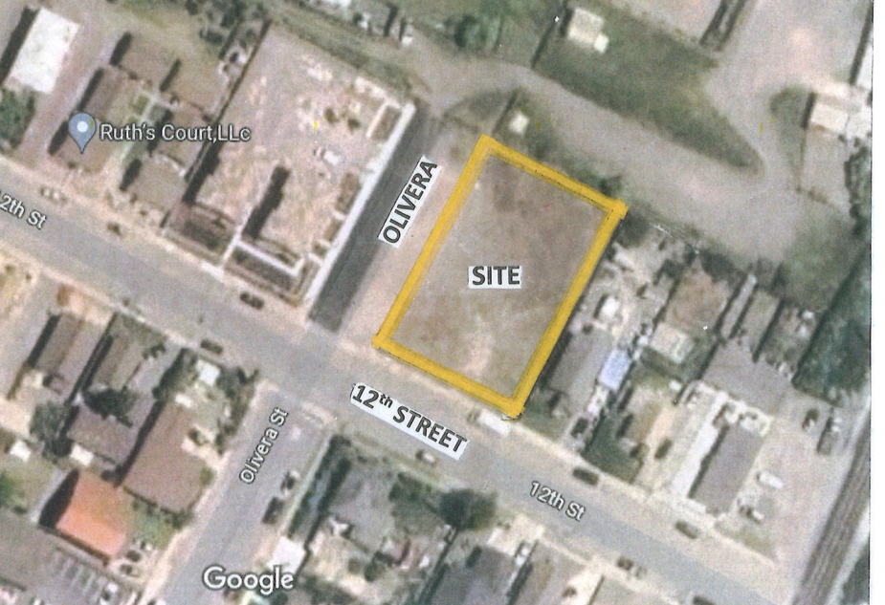
Project Site

Slide 4
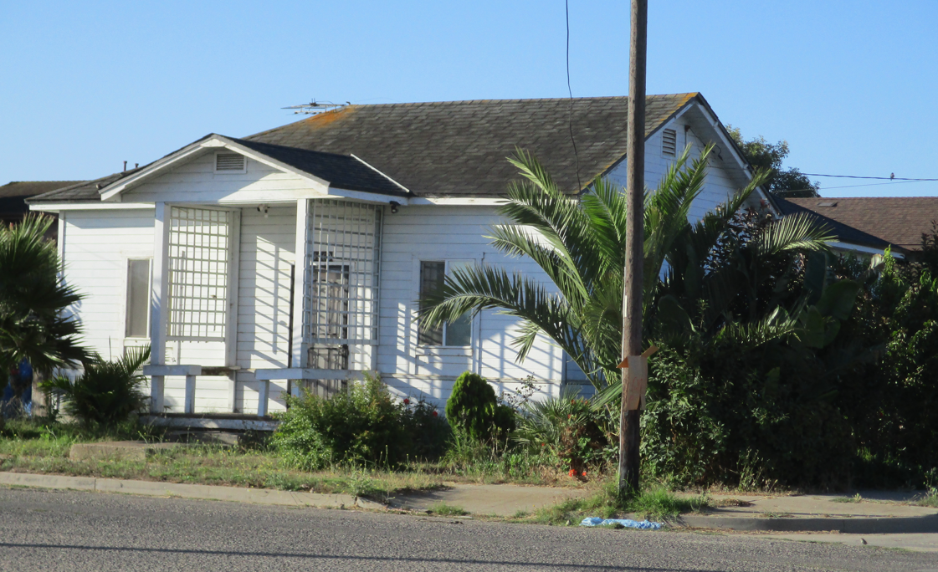
South south

Slide 5
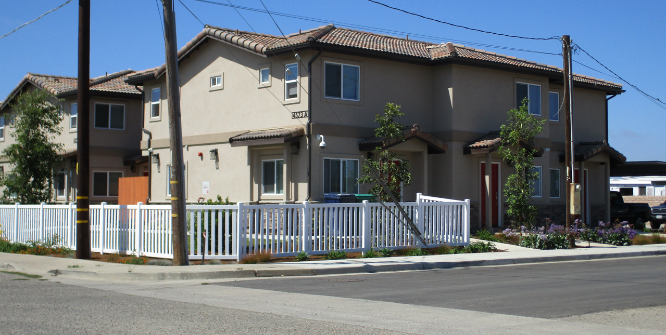
West - New Apartments

Slide 6
Design Review Permit
Municipal Code Section 18.73.010:
Design Review Permit required for any multi-family project containing three or more housing units.
Only the 9-Apartments are permitted under Design Review Permit.
Two ADUs are considered separately by Planning.

Slide 7
Accessory Dwelling Units
Government Code 65852.2:
(A)(1)(2): A permit application to create an ADU shall be permitted ministerially without discretionary review or a hearing…
(A)(1)(3): An Ordinance adopted by a local agency shall provide an approval process that includes only ministerial provisions for the approval of ADUs and shall not require any discretionary processes…

Slide 8
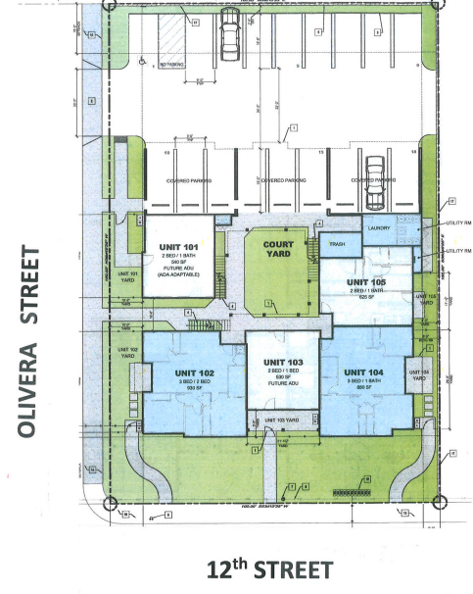
SITE PLAN

Slide 9
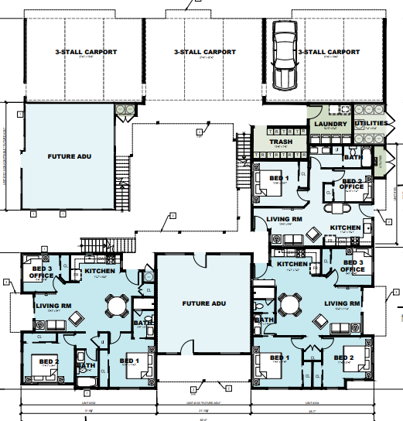
FIRST FLOOR PLAN

Slide 10
Zoning Code Conformance
Density: GMC18.32.020(A): One unit per 1,452 SF. - Met.
Building Setbacks: 18.52.040(D) - Met.
Parking (Apartments): 18.60.050(2) - Met.
ADU Parking: 18.53.050 (G)(5)(b):
Zero parking proposed. - Met @ Zoning Clearance.
Building Height: 18.52.020 35-foot Maximum. - Met.

Slide 11
Zoning Code Conformance
Landscape Coverage: 18.64.040(A) - 10% required - 27% Provided. Met.
Apartment Private Yards (Ground Floor): 18.52.100 - 100 SF minimum. Provided 136 to 300 SF. - Met.
Apartment Private Yards (Upper Floor): 18.52.100 - 50 SF minimum. Provided - 52 to 103 SF. Met.
ADUs Private Yards 18.53.050 (C)(11): Required: 225 SF - Provided 225 SF at Zoning Clearance.
ADU Parking: GMC________: Yes

Slide 12
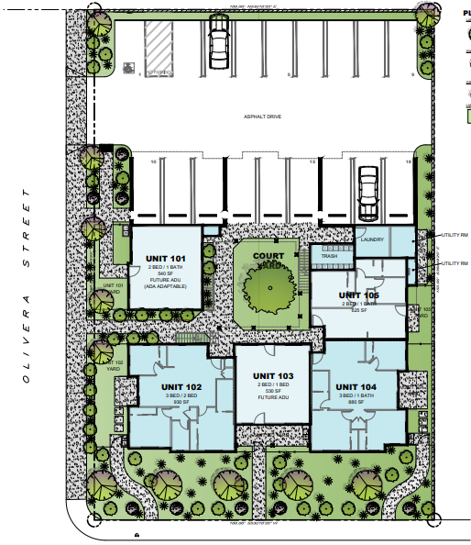
LANDSCAPE PLAN

Slide 13
SOUTH ELEVATION

Slide 14
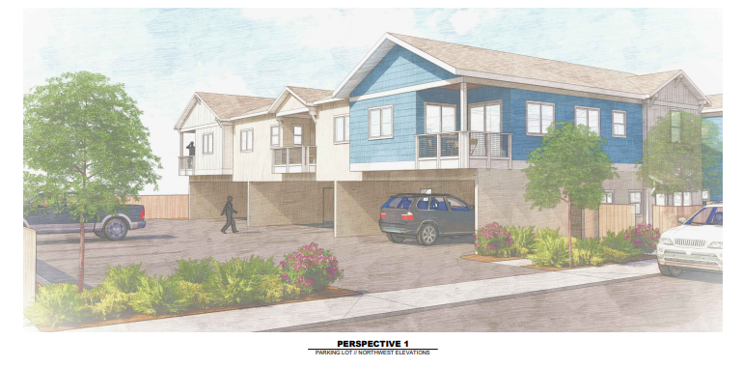
Conceptual View – South Side

Slide 15
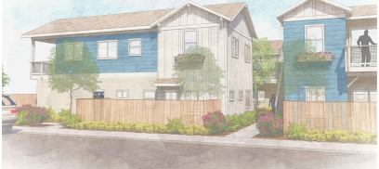
West Side – Olivera Street

Slide 16
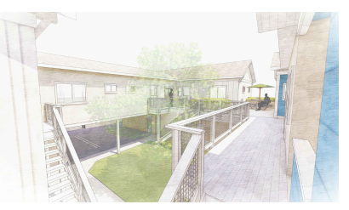
Conceptual - View over Courtyard

Slide 17
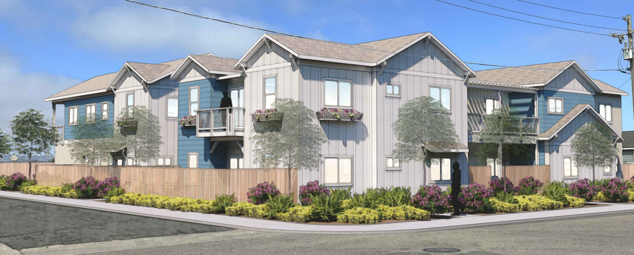
Conceptual View – Southwest Corner

Slide 18
CEQA Review
Class 32 Exemption
Applies to Infill Projects within City limits on less than five acres.
Site is adequately served by public utilities and municipal services; and
Site has no value as habitat for endangered spacies.

Slide 19
General Plan Conformance
Land Use Policy LU-1.4:
The City will support the development of vacant and underutilized land with land uses that increases livability and benefits to the community:
Project: High quality residential development, compatible with the neighborhood, on a vacant/underutilized site,

Slide 20
Conclusion
In summary:
9 Apartments and 2-ADUs support State objectives and City Housing Element goals to increase housing supply.
Project will finance public improvements including completion of the segment of Olivera Street.
Provide quality Housing both in livability for residents and in appearance for the neighborhood.

Slide 21
Recommendation
Adopt Resolution No. 2023-73 approving Design Review Permit 2023-055-DR and the CEQA Exemption for for the 12th Street Apartments.

