Slide 1
California State Parks
Oceano Dunes District

Slide 2
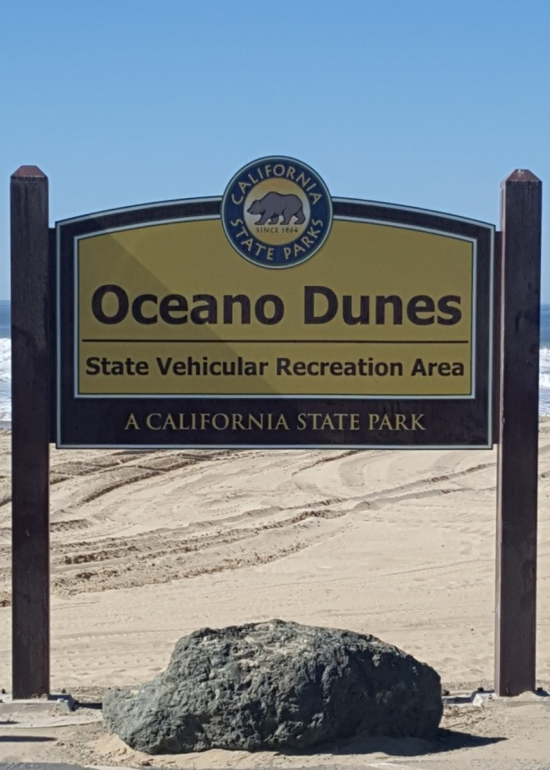
Who we are…
Oceano Dunes District manages approximately 5,500 acres
Oceano Dunes State Vehicular Recreation Area
Oso Flaco
Pismo State Beach
North Beach Campground
Oceano Campground
Pismo Dunes Natural Preserve
Pismo Lake

Slide 3
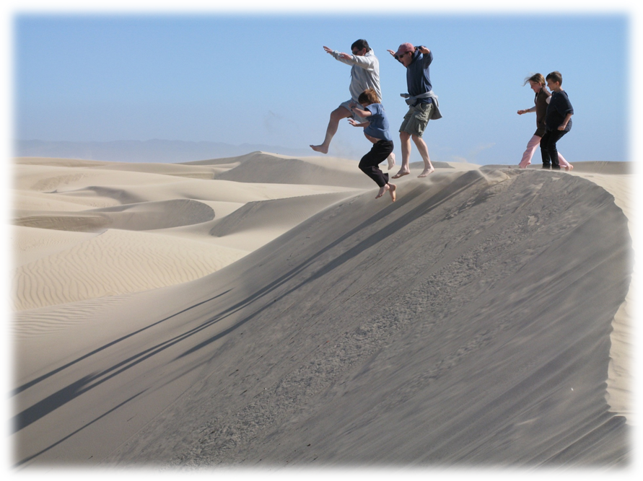
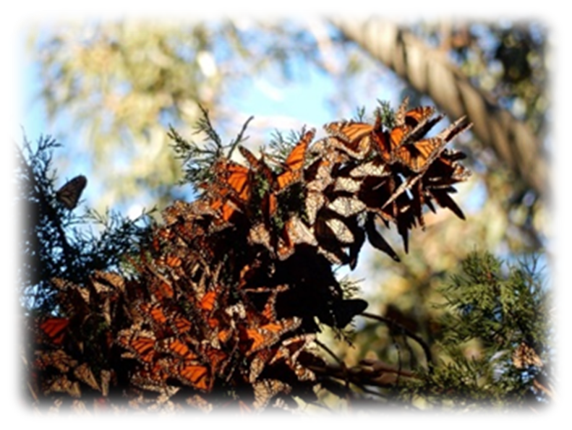
What we do…
Annual visitation of approximately 2 million
Diverse recreational opportunities
Visitor Services
Resource Management Programs
Interpretive Programs

Slide 4
Public Works Plan (PWP)
Long-range land use and development plan in compliance with the California Coastal Act and California Resources Code (14 CCR § 13353) Reviewed and certified by the California Coastal Commission
Covers State Beach and SVRA operations and site specific development projects
1975 General Development Plan
Amended 1982 and 1994
Predates California Coastal Act of 1976
Replaces the existing 1982 Coastal Development Permit

Slide 5
PWP Process
Document existing conditions
Consider improvement projects and management programs to improve access for motorized and non-motorized recreation opportunities
Integrate other planning efforts and ensure consistency with the General Development Plan
Develop policies, goals and guidelines
Concurrently, prepare an Environmental Impact Report for compliance with the California Environmental Quality Act for the PWP and implementation of the proposed park improvement projects.

Slide 6
Environmental Impact Report Topics
Aesthetics
Agriculture and Forestry Resources
Air Quality
Biological Resources
Cultural Resources
Energy
Geology and Soils
Greenhouse Gas Emissions
Hazards and Hazardous Materials
Hydrology and Water Quality
Land Use and Planning
Mineral Resources
Noise
Population and Housing
Public Services
Recreation
Transportation and Traffic
Tribal Cultural Resources
Utilities and Service Systems

Slide 7
Other Planning Efforts
Habitat Conservation Plan and Natural Communities Conservation Plan
Oceano Dunes District Interpretive Management Plan
Coordination with the San Luis Obispo Air Pollution Control District on air quality within the region
Coastal Dunes Dust Control: requirements and emissions standards
Stipulated Abatement Order

Slide 8
PWP Projects
Oso Flaco Campground and Public Access
Park Operation Yard
Oceano Campground Infrastructure Improvement
Pier Ave & Grand Ave Entrance Stations
Pier Ave Lifeguard Tower
North Beach Campground Facility Improvements
Pismo State Beach Boardwalk
Pismo State Beach Butterfly Grove

Slide 9
Park-wide Proposed Options

Slide 10
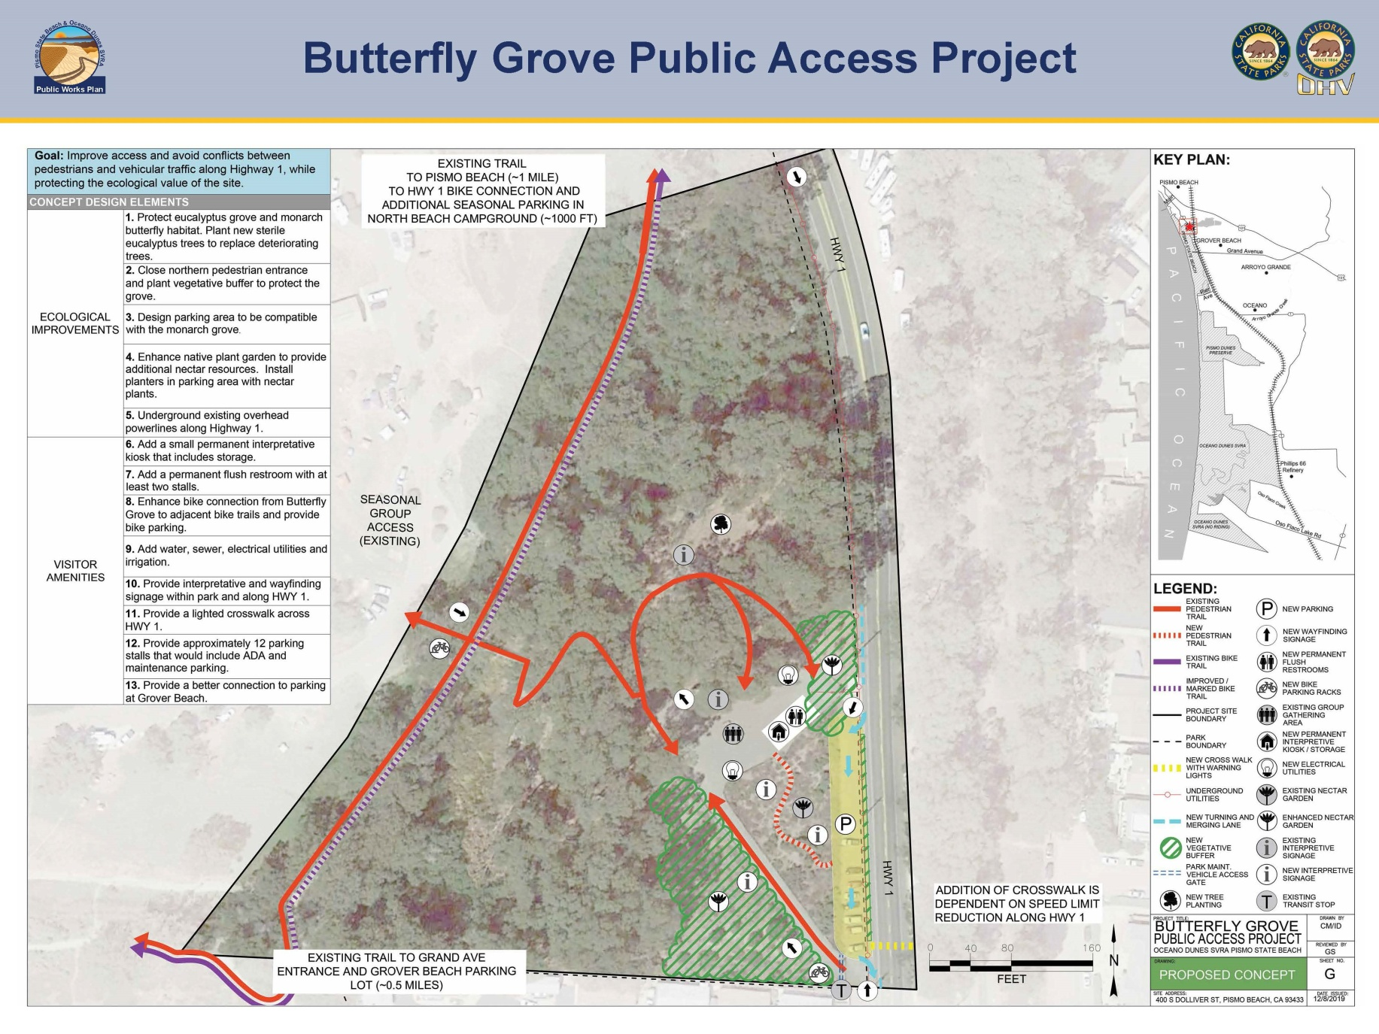
Butterfly Grove Proposed Concept

Slide 11
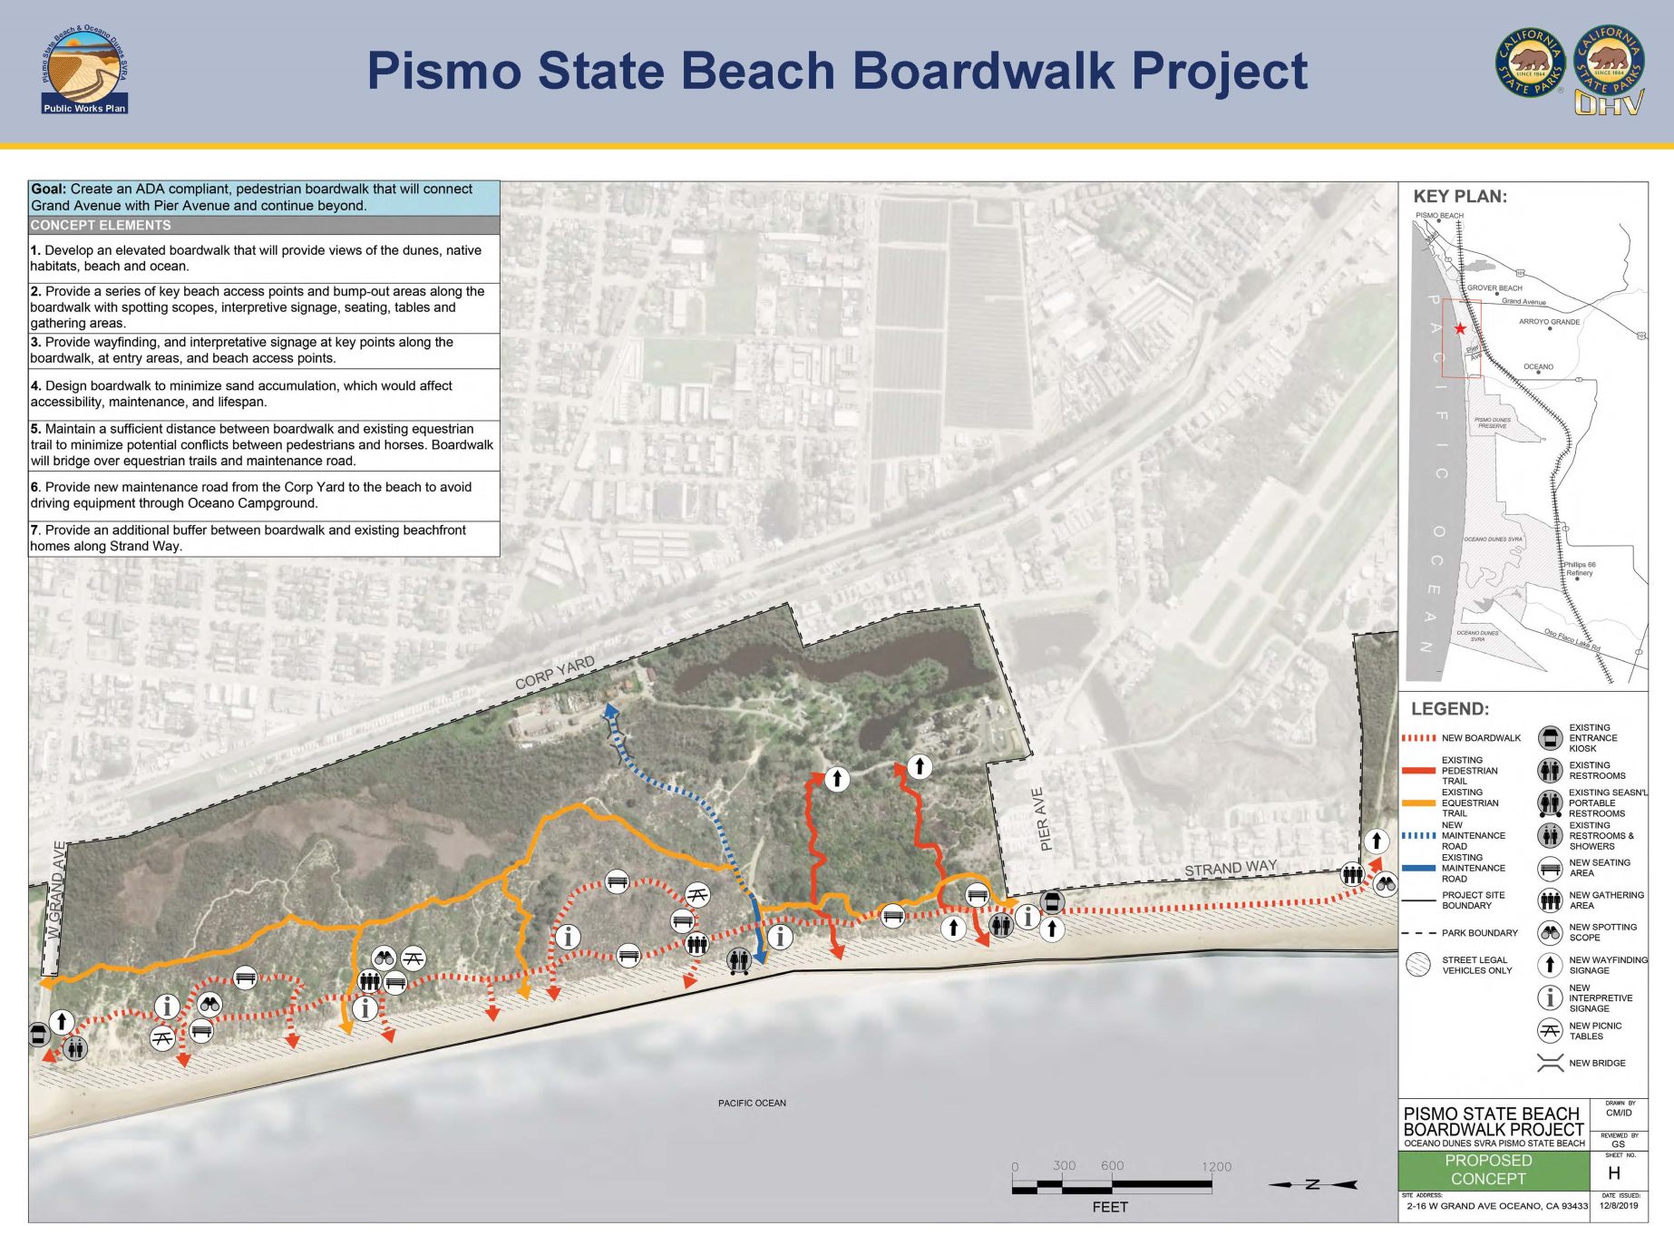
Boardwalk Proposed Concept

Slide 12
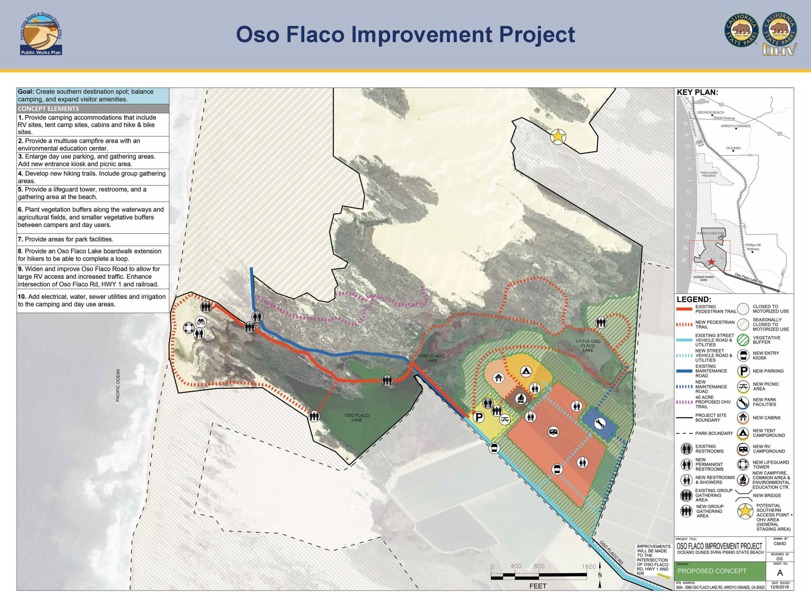
Oso Flaco Proposed Concept

Slide 13
PWP Timeline

Slide 14
PWP Next Steps
Completed Public Workshop 3 completed
December 10 & 11, Arroyo Grande & Bakersfield
Summarize public input on PWP Proposed Options and Proposed Project Concepts public meetings
Prepare Draft PWP
Additional Updates to State Coastal Commission (Feb, Jun, Oct 2020)
PWP environmental review (summer 2020)
PWP approval and EIR Certification (fall 2020)

Slide 15
Contact Us
Visit
https://OceanoDunesPWP.com
Subscribe
https://OceanoDunesPWP.com/en/contact
Questions
info@OceanoDunesPWP.com.

