Slide 1
HERBNJOY
GUADALUPE ERUDITE VENTURES
COMMERCIAL CANNABIS RETAIL STOREFRONT BUSINESS APPLICATION

Slide 2
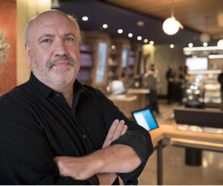
MEET OUR OWNERS
QUALIFICATIONS
DR. RAJAN “RAJ” DAVE
Chief Executive Officer
4+ Years of Cannabis Retail Experience
Owns / Operates 4 licensed cannabis retail locations in CA
6 additional cannabis retail businesses scheduled to open in 2022-2023
Integral part of the day-to-day operation of each cannabis business owned
JEFF LINDEN
Chief Operating Officer
35+ Years of Retail Experience
20+ Years of Senior Management Experience
6+ Years of Cannabis Retail Experience
Owns / Operates 5 licensed cannabis retail locations in CA
Integral part of the day-to-day operation of each cannabis business owned

Slide 3
BUDGETS & PROJECTED EXPENSES
BUSINESS PLAN - BUDGETS
STARTUP COSTS……………………………………………………………………………….. $1.75M
PROOF OF CAPITALIZATION…………………………………………………………………..$1.8M
(in debt financing, substantially covering the projected budget)
SCHEDULE FOR BEGINNING OPERATIONS…………………….........…7 months from permit award

Slide 4
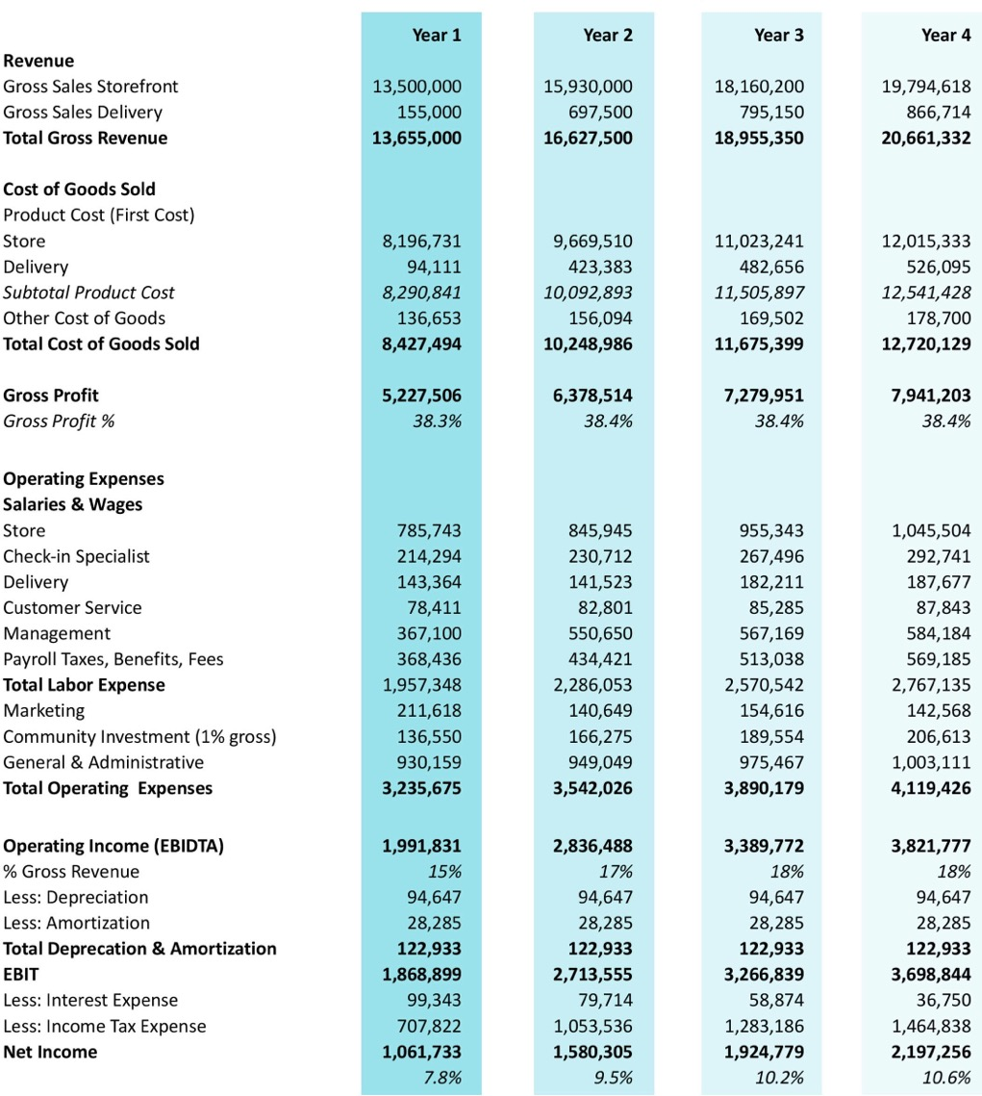
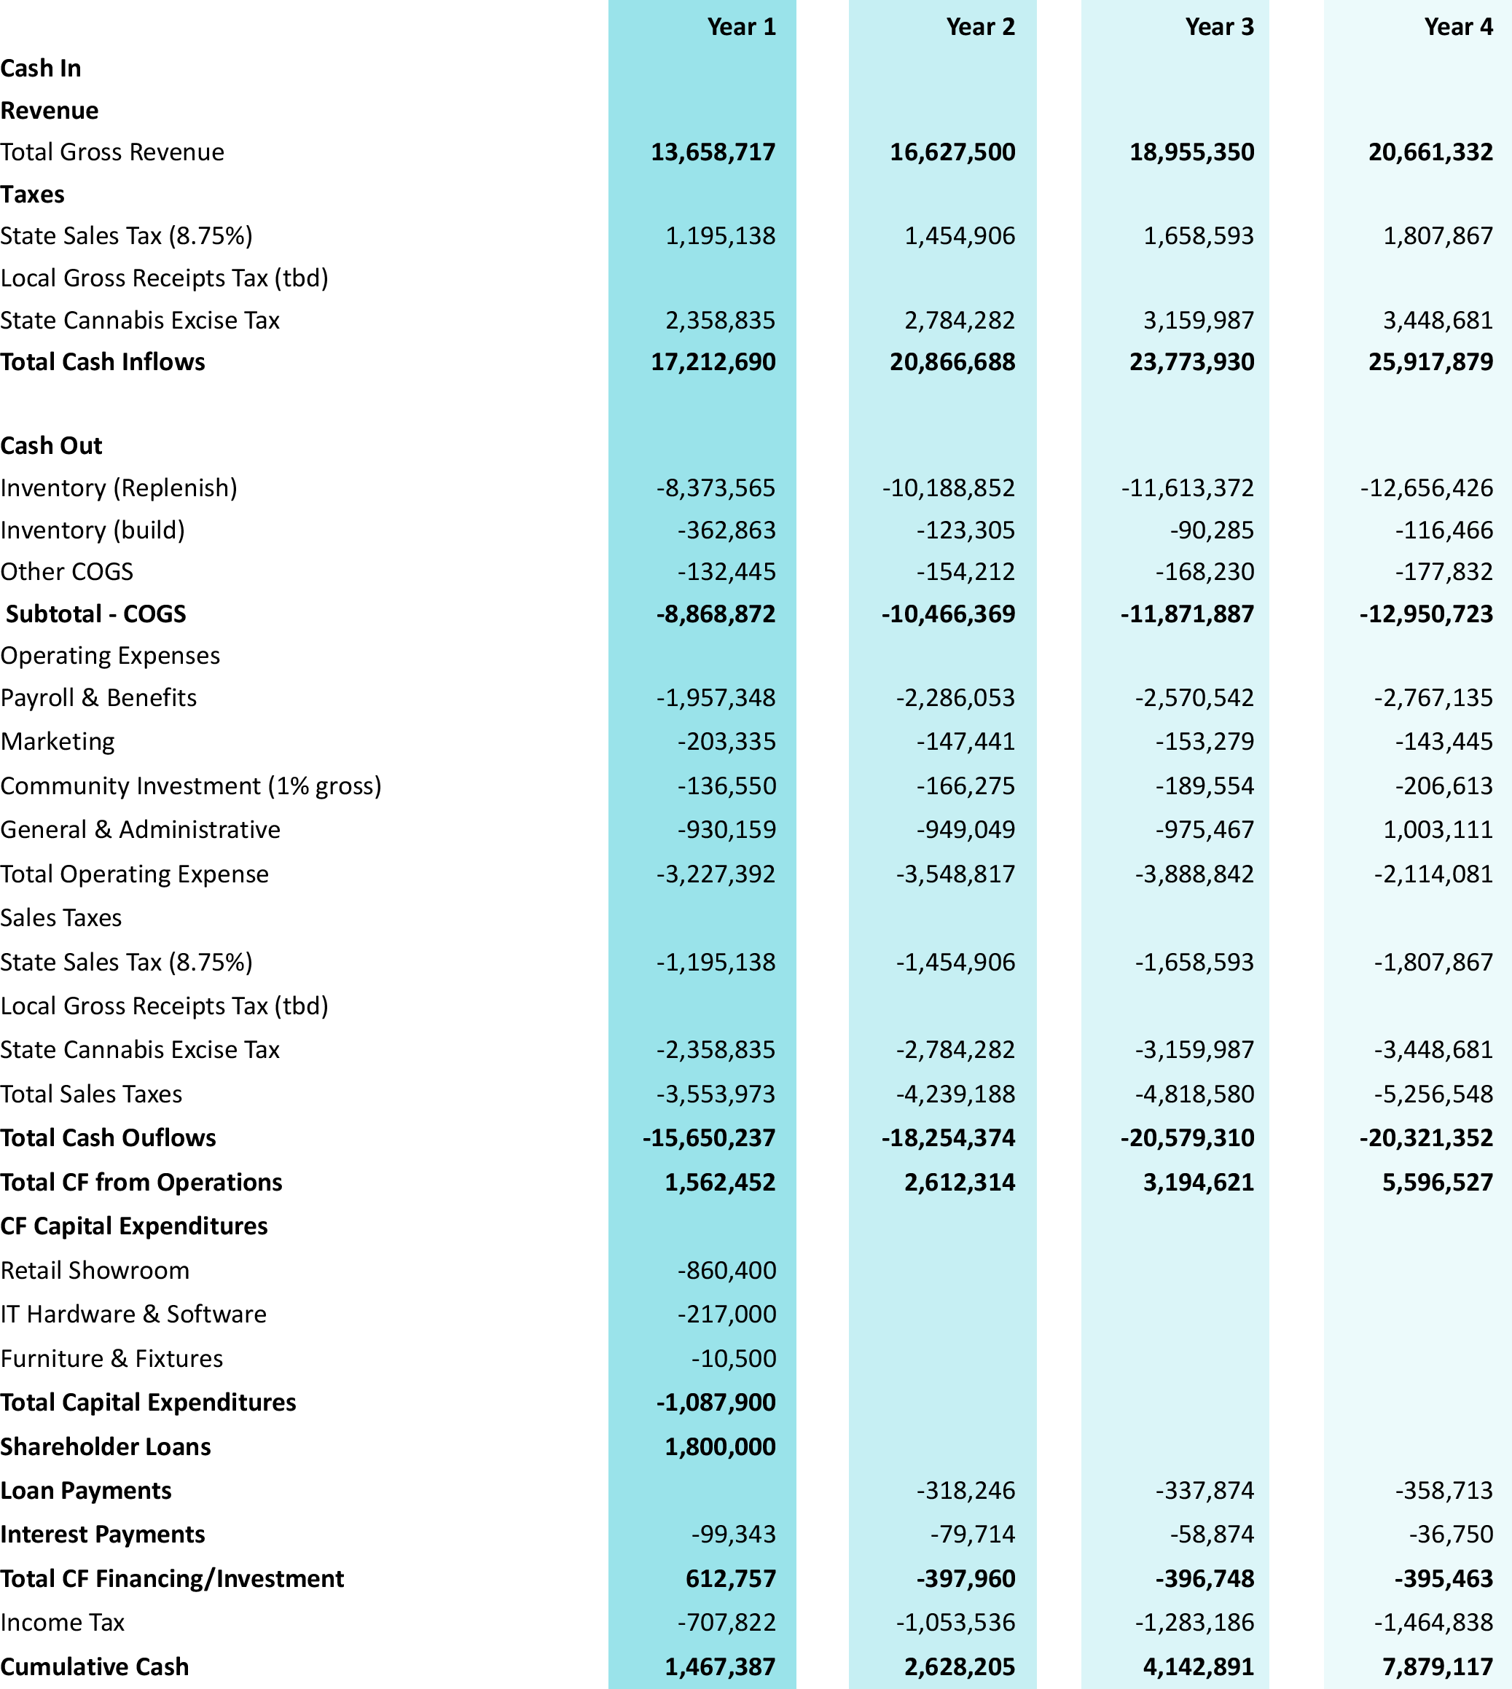
PRO FORMA
BUSINESS PLAN - PRO FORMA

Slide 5
DAY-TO-DAY OPERATIONS
BUSINESS PLAN - OPERATIONS
Hours of Operation
9 AM - 9 PM, seven days a week
Customer Check-in Procedures
HerbNJoy only allows customers 21 years of age and older, and patients 18 years of age and older with valid medical documentation to enter our store.
We check each individual’s identification and documentation twice:
Outside of our facility through a remotely monitored camera
Inside of our Lobby, by our Receptionist
Inventory Control Procedures
All inventory is tracked through METRC and Treez.
Inventory is regularly reconciled for accuracy.
HerbNJoy carries high-quality cannabis from reputable brands.
Delivery Procedures
Delivery to residents of Guadalupe and nearby areas.
Customers may place orders online, by telephone, or through 3rd party apps.
3 delivery vehicles equipped with:
GPS tracking
Lockbox
Dash cams
Alarm system

Slide 6
100% Local Hires
LABOR, EQUITY, DIVERSITY, AND INCLUSION PLAN - HIRING
LABOR & EMPLOYMENT
COMPETITIVE PAY
Living Wage
HerbNJoy will hire 40 local Guadalupe residents to staff our store in Year 1.
Conduct community outreach to spread the word about our job opportunities
Reach community members seeking employment by working directly with community organizations like:
Guadalupe Business Association
Santa Maria Valley Chamber of Commerce
Center for Employment Training Santa Maria
Santa Barbara County One-Stop Workforce Re source Center
Seek referrals
Advertise and host informational sessions and job fairs at our facility
Wages start at $22.50/ hour
Exceeds living and minimum wage
Management can make over $100,000/year
Health Benefits
Health, dental, and vision insurance
Financial Incentives
40% employee discount
Bonuses
$5K annual employee choice benefit
Time Off
Up to 7 days of paid time off
1 week of paid vacation per year of service
Paid sick leave
Volunteer time off
Family Benefits
Maternity and paternity leave
Flexible parental time schedule
Green Incentives
Green commute stipend
Local Recruitment Plan
Comprehensive Benefits Package

Slide 7
LABOR, EQUITY, DIVERSITY, AND INCLUSION PLAN - DIVERSITY, TRAINING, AND COLLECTIVE
BARGAINING
LABOR & EMPLOYMENT
Equity, Diversity and Inclusion
HerbNJoy is a minority-owned company
Diversity committee will hold company accountable
Employee training on diversity, equity, inclusion, and anti-discrimination policies
Diversity programming & initiatives
Partnerships with organizations committed to diversity and inclusion efforts
Employee Training
Employee Orientation
4 weeks initial employee training
Training covers:
Products
SOPs
Safety
Security
Continuing Education
Tuition assistance to pursue independent continuing education
In-house continuing education
3rd party certified skills training programs
Retail Management
Inventory Control
Receiving/Fulfillment/Shipping
Ongoing Training
At least once per year
Ensures employees are familiar with changes in:
Job duties
Law
SOPs
HerbNJoy will enter into an LPA with the local union, upon reaching 20 employees.
Collective Bargaining

Slide 8
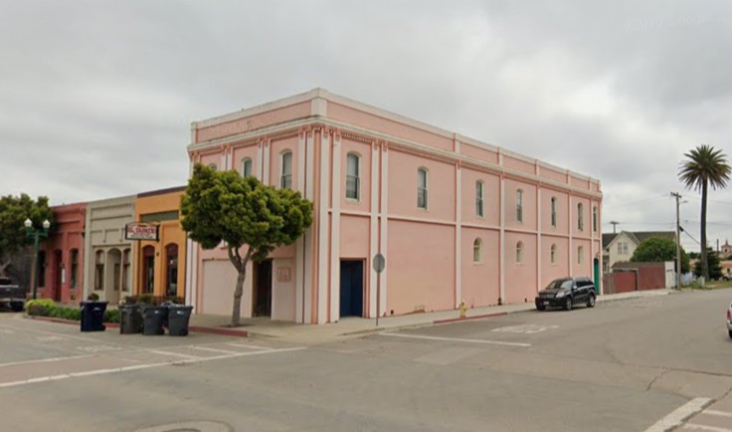
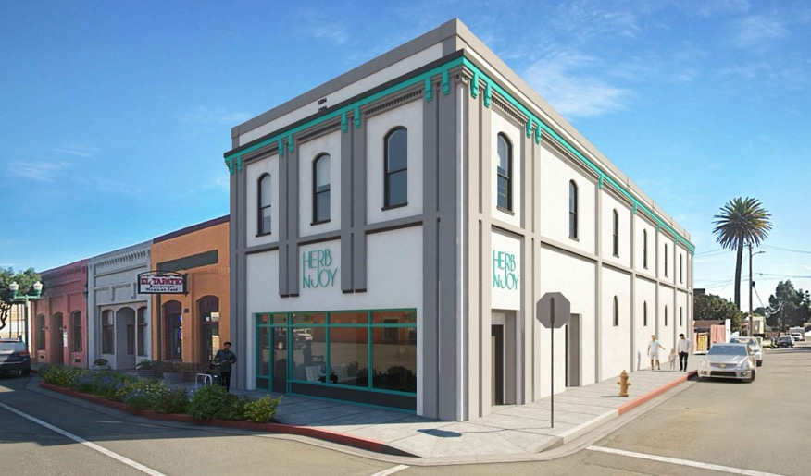
LOCATION OVERVIEW
PROPOSED LOCATION
Address
910 Guadalupe St. (first floor only)
Square Footage
2,340
Zone
General Commercial (G-C)
Parking
9 total parking spaces:
1 designated ADA parking space in our private lot
A minimum of 8 designated spaces at 975 Guadalupe lot, with the ability to add additional spaces as desired by the City to accommodate our retail operations
Sensitive Uses
More than 940 feet away from the nearest sensitive use
Not on a well-traveled path to any sensitive use
Planned Tenant Improvements
Pave parking lot
Add security lighting
Remove and replace current fence
Install tasteful & compliant signage

Slide 9
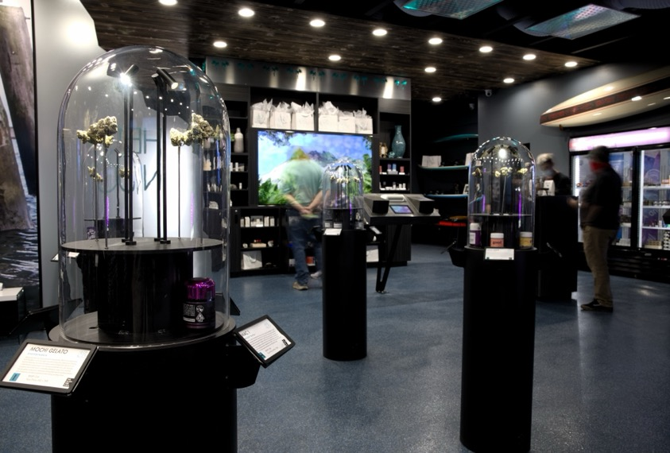
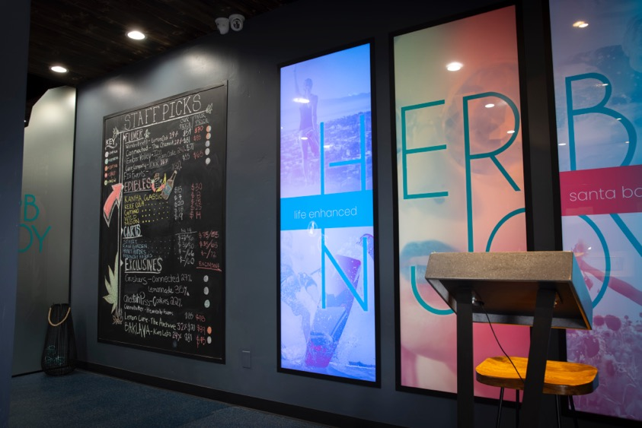
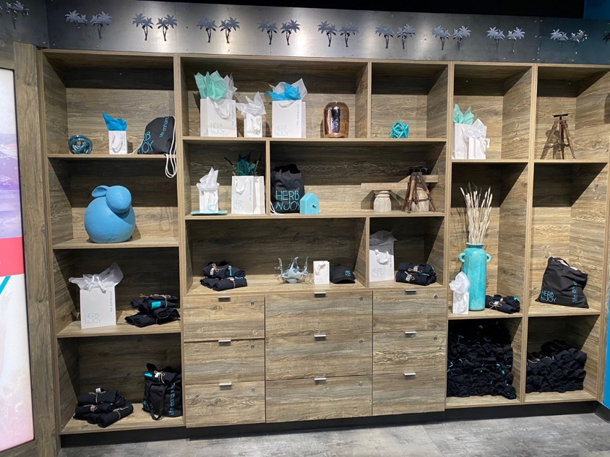
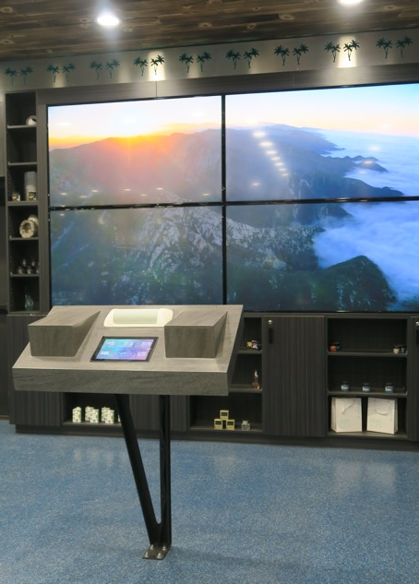
FLOOR PLAN
INTERIOR PHOTOS

Slide 10
NEIGHBORHOOD COMPATIBILITY PLAN & PUBLIC RELATIONS PLAN
NEIGHBORHOOD COMPATIBILITY PLAN -
PUBLIC RELATIONS PLAN
Complaint Response Plan
Designating a Community Relations Contact/Representative and providing neighbors with his or her contact information
Multiple avenues for feedback:
In store
By email
Through our dedicated 24-hour landline telephone line, or
At our quarterly community meetings
Responding to all individuals providing input within 24 hours
Maintaining a log of all feedback received
Community Outreach and Neighbor Engagement Plan
Introductory welcome letter
Outreach to a variety of community members and groups
Blog
On-site literature
Quarterly meetings
Educational sessions
Community events
Business 2 business partnerships
Discount programs

Slide 11
NEIGHBORHOOD COMPATIBILITY PLAN - PROACTIVE MANAGEMENT & ODOR/WASTE MITIGATION
PROACTIVE MANAGEMENT & ODOR/WASTE MITIGATION
Proactive Management to Avoid Nuisance
Heightened security
24/7 video surveillance
24/7 on-site security personnel
Security and anti-nuisance policies:
No loitering
No on-site consumption
No noisy or disruptive behavior
No littering
No secondary sales
Clean street policy
Building strong relationships with the community
Waste Management Plan
Storage of cannabis waste in secured and locked receptacles in limited-access areas
Cannabis products are rendered useless and unrecognizable prior to disposal when required by state law:
Disposal of cannabis or cannabis products which have failed:
Internal quality testing
Quality assurance review by a distributor; or
Regulatory compliance testing
GAIACA processes and removes all cannabis waste from the facility
Odor Mitigation Plan
All cannabis contained in sealed packaging, reducing odor at facility
Odor control devices & equipment:
Negative pressurization
Activated carbon filters
HVAC
Odor neutralizing surface materials

Slide 12
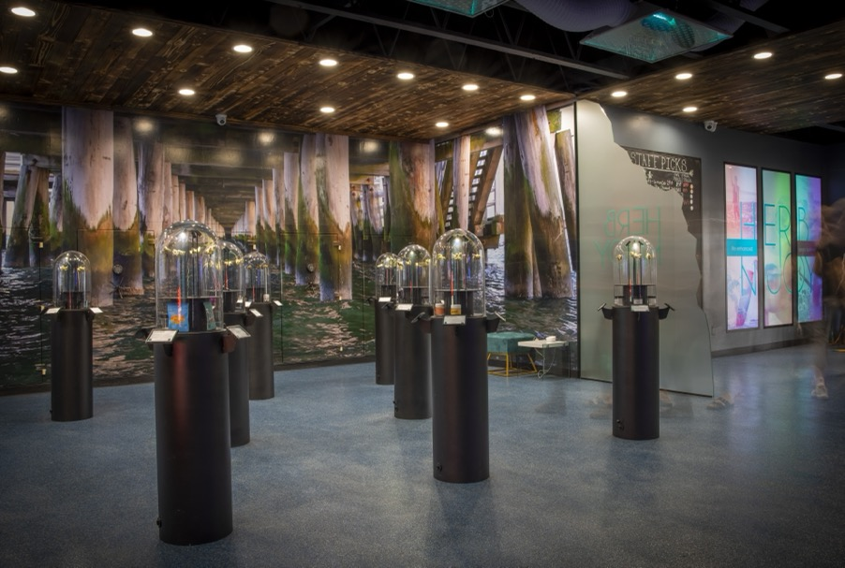
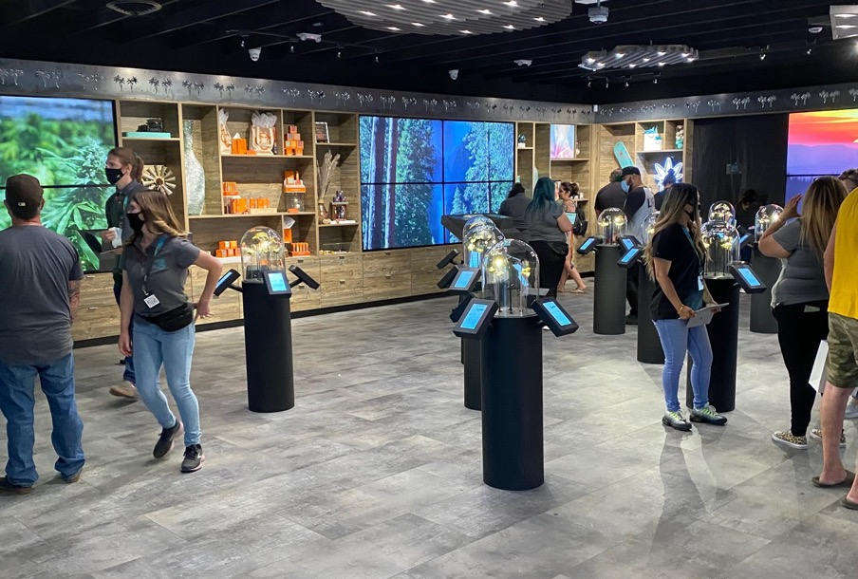
SAFETY PLAN
SAFETY PLAN
Prepared by Robert Rowe, a professional fire prevention and suppression consultant.
Employee Safety Training
Conducted at orientation and on an ongoing basis
Covers topics including but not limited to:
Accident and incident reporting procedures
Roles and responsibilities in an emergency
Location and use of common emergency equipment
Fire Prevention, Fire Safety, and Fire Response
Evacuation Routes and Assembly Areas
Emergency Lockdown and Shutdown Procedures
Medical Emergency Procedures
CPR/ First Aid Training for certain employees
Cal/OSHA training

Slide 13
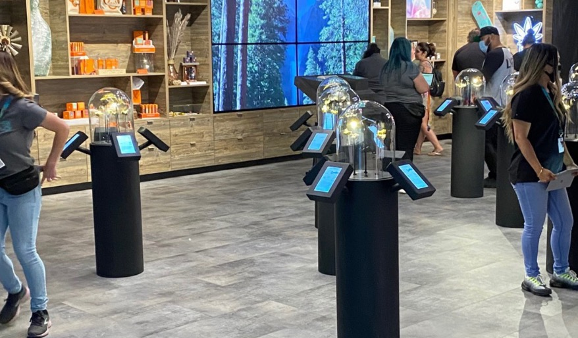
SECURITY PLAN
SECURITY PLAN
Security Plan
Prepared by Terry Blevins, a professional security consultant with 35+ years of experience
Operational Security Measures
Access and visitor control procedures
Inventory control procedures
Cash handling procedures
Perimeter Security Measures
24/7 video surveillance monitoring
Centrally monitored intrusion alarm system
Motion sensors
Panic alarms
24/7 on-site security personnel
Locks
Mosquito devices
Security lighting
Employee Security Training
Conducted at orientation and on an ongoing basis
Covers topics including but not limited to:
Product handling
Crime and loss prevention
Burglary and robbery protocol
Incident observation and reporting techniques
Surveillance detection
Disaster preparedness
Common safety hazards
Summary of Security Plan

Slide 14
COMMUNITY BENEFITS & INVESTMENTS PLAN
COMMUNITY BENEFIT AND INVESTMENT PLAN
Funding
HerbNJoy is prepared to donate 1% of our gross revenues to fund our Community Benefits and Investments Plan.
Community Advisory Board
Community Advisory Board will be composed of influential Guadalupe community members
Community Advisory Board will select and oversee distribution of funds to community organizations
Areas of Focus
Social equity
Economic growth
Downtown Revitalization
Methods of Giving
Financial contributions
Volunteer time
In-kind Donations
Community Organizations
Little House by the Park
Los Amigos de Guadalupe
The Guadalupe Nipomo Dunes Center
The Guadalupe Business Association
100% Local Hiring
Proprietary & Confidential Information of Adamant Law Group, Ventura Erudite Ventures. Not for Publication.

Slide 15
LIFE ENHANCED
THANK YOU

