Slide 1
Guadalupe City Council
Conditional Use Permit and Design Review for the
823 Guadalupe Street Apartments
Presented by
Bill Scott, Contract Planning Consultant
Guadalupe City Planning Department
November 8, 2022

Slide 2
Project Description 1
CUP 2022-027-CUP and Design Review 2022-030-DR to allow:
24 market-rate apartments in a new 3-story apartment building; and
Remodel upstairs portion of existing two-story building to add three (3) apartment units for very low-income households.
Total 27 apartments. Proposed under state Government Code 65915 (Density Bonus Law).

Slide 3
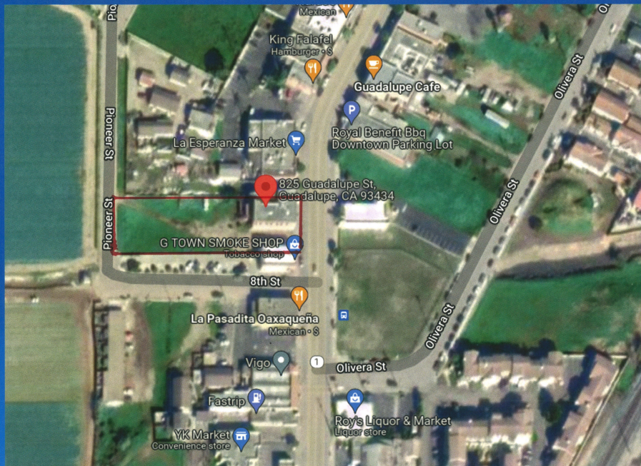
Project Site

Slide 4
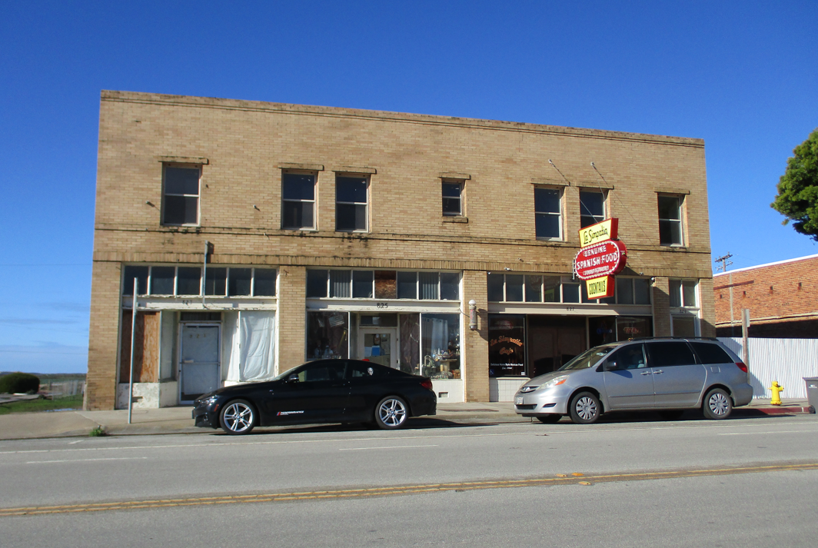
823 - 829 Guadalupe St.

Slide 5
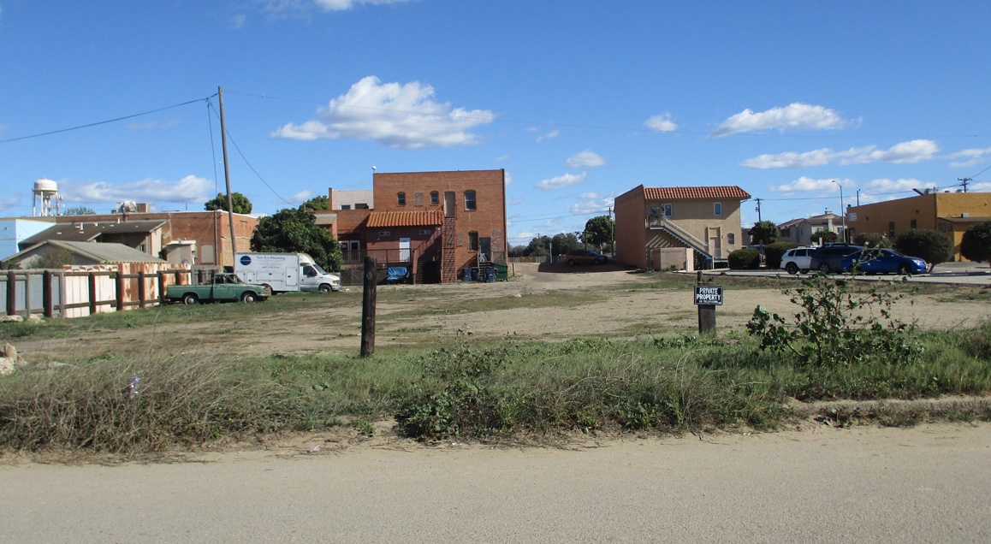
Back View from Pioneer St.

Slide 6
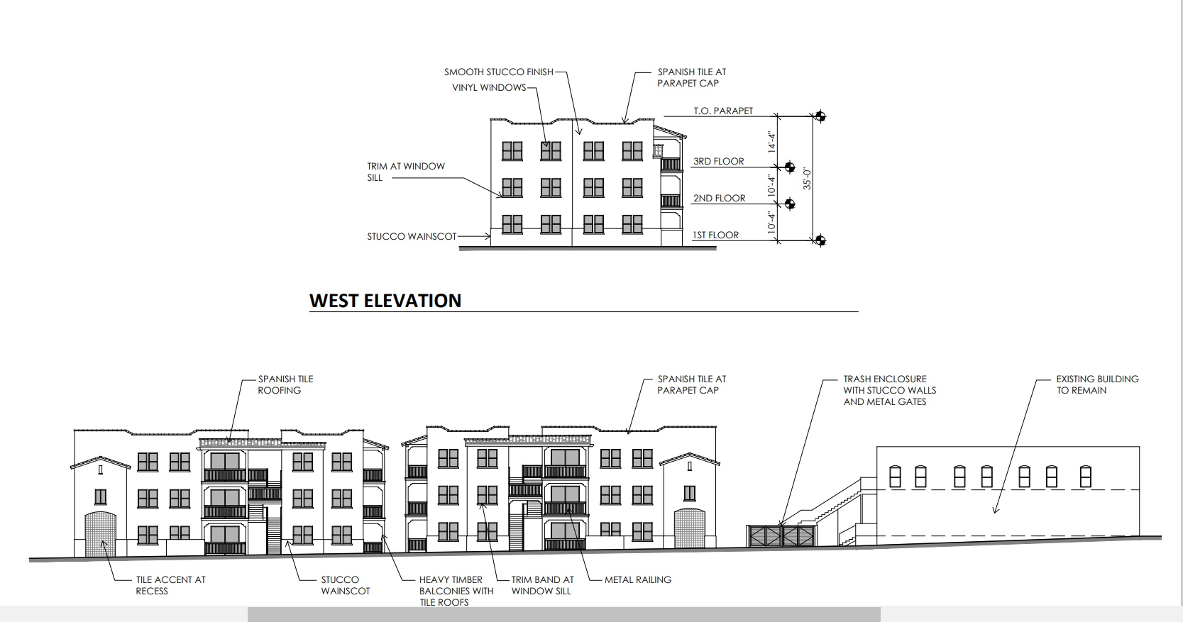
Existing Building & New Buildings

Slide 7
Government Code 65915
Density Bonus Law provides:
Increase in residential density over local government’s General Plan and/or zoning.
Allows certain concessions or incentives (i.e., parking reduction, setback reduction).
building
Behind the front building

Slide 8
Density Bonus
Lot = 30,492 SF
30,492 Divided by 1,700 SF = 17.93 apartments.
[Municipal Code Section 18.30.030(A)]
15% very low-income units = 50% density bonus (Government Code 69516(f)(2).
17.93 apartments plus 50% (density bonus) = (26.89) or 27 apartments (rounded).

Slide 9
Project Incentives
Government Code 85915(2)(C) permits:
Three (3) Incentives or concessions for projects that include…at least 15 percent of dwellings for very low-income households.

Slide 10
Proposed under 65915
Nine (9) additional apartments above what is normally allowed = 27 units
Three (3) Incentives/Concessions:
Setback Reduction: (to 1-foot) west side,
Parking Reduction: Instead of two (2) parking spaces per unit (54 spaces); one space per unit = 27 spaces;
No covered parking.

Slide 11
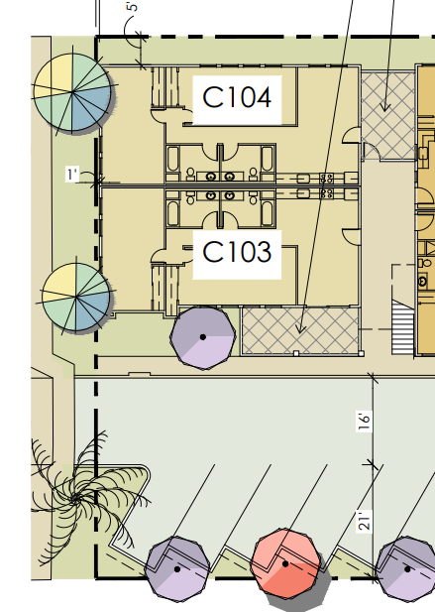
Reduced Rear Yard Setback

Slide 12
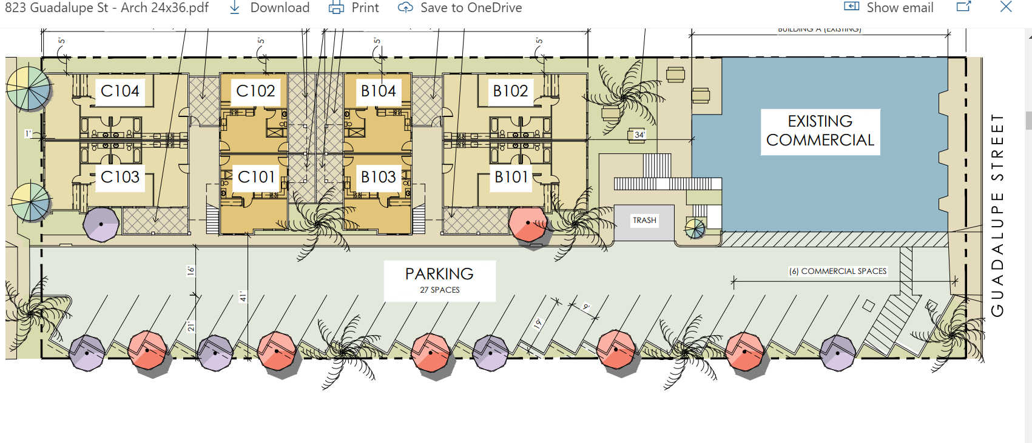
27 Uncovered Spaces

Slide 13
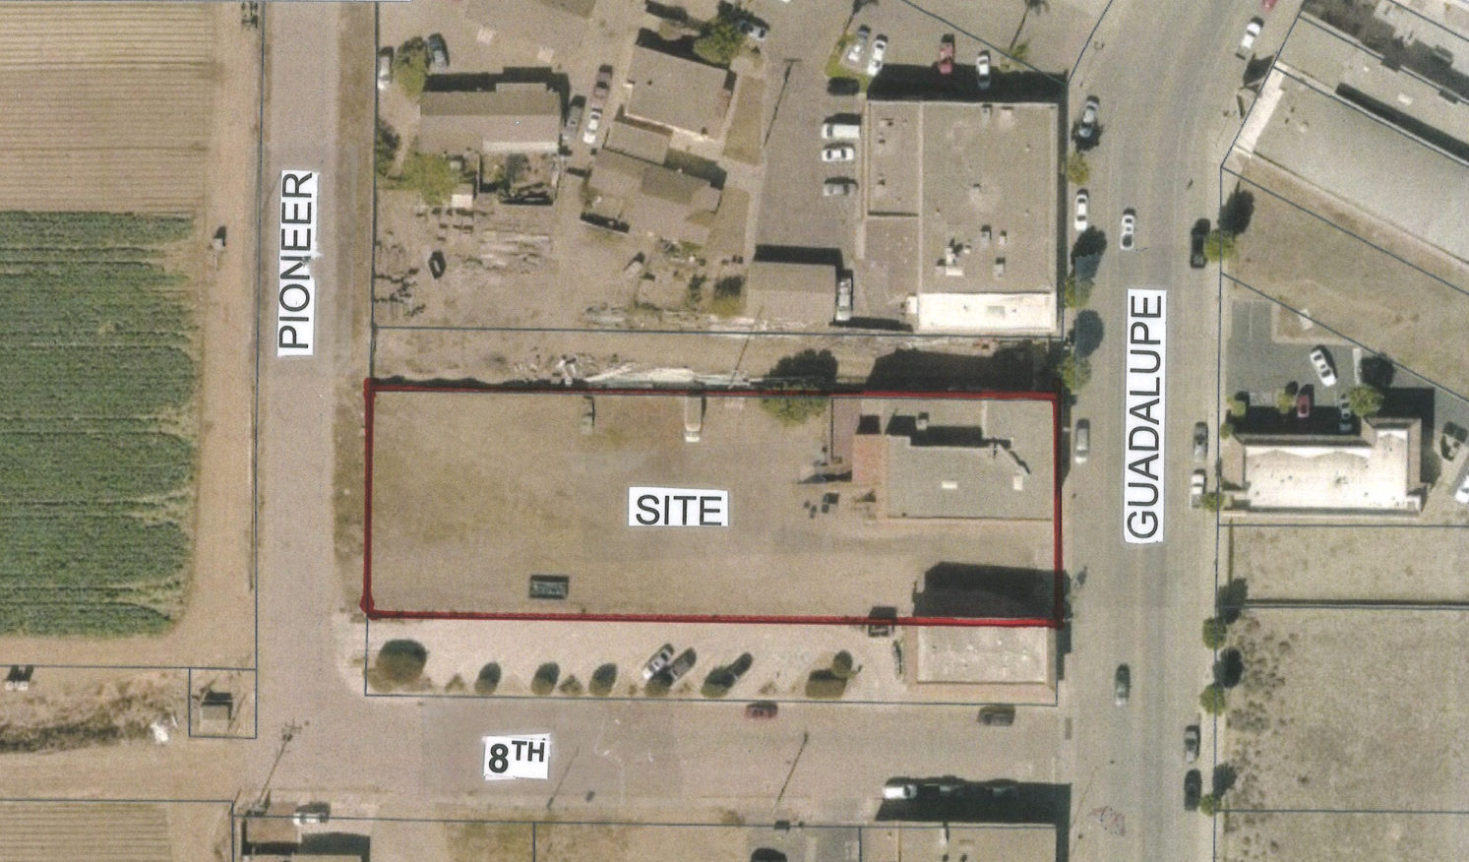
Aerial Site Map

Slide 14
Results?
Higher density than normal: Increase of nine (9) apartments (3 for - very low-income households).
Setback Reduction: The Building Official stated no adverse safety impact by the building setback reduction – 15-foot parkway will function (to some degree) as a yard.
Parking Reduction: Some degree of on-street parking can be anticipated.

Slide 15
Design Review
Code Section 10.73.010: Design Review is required for any development in the Central Business District fronting Guadalupe Street:

Slide 16
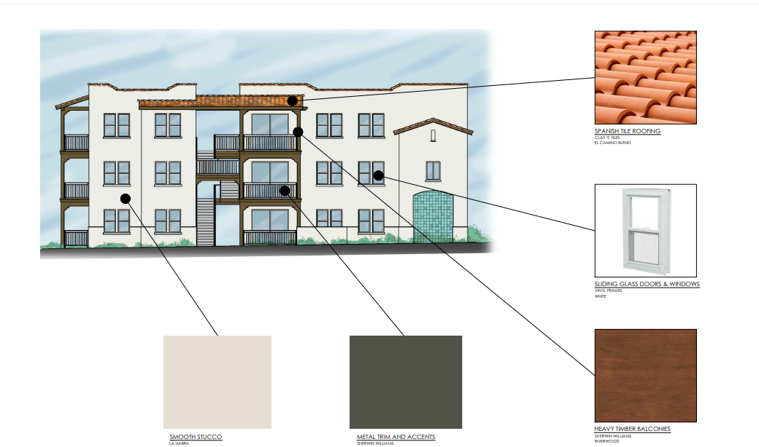
Building Design

Slide 17
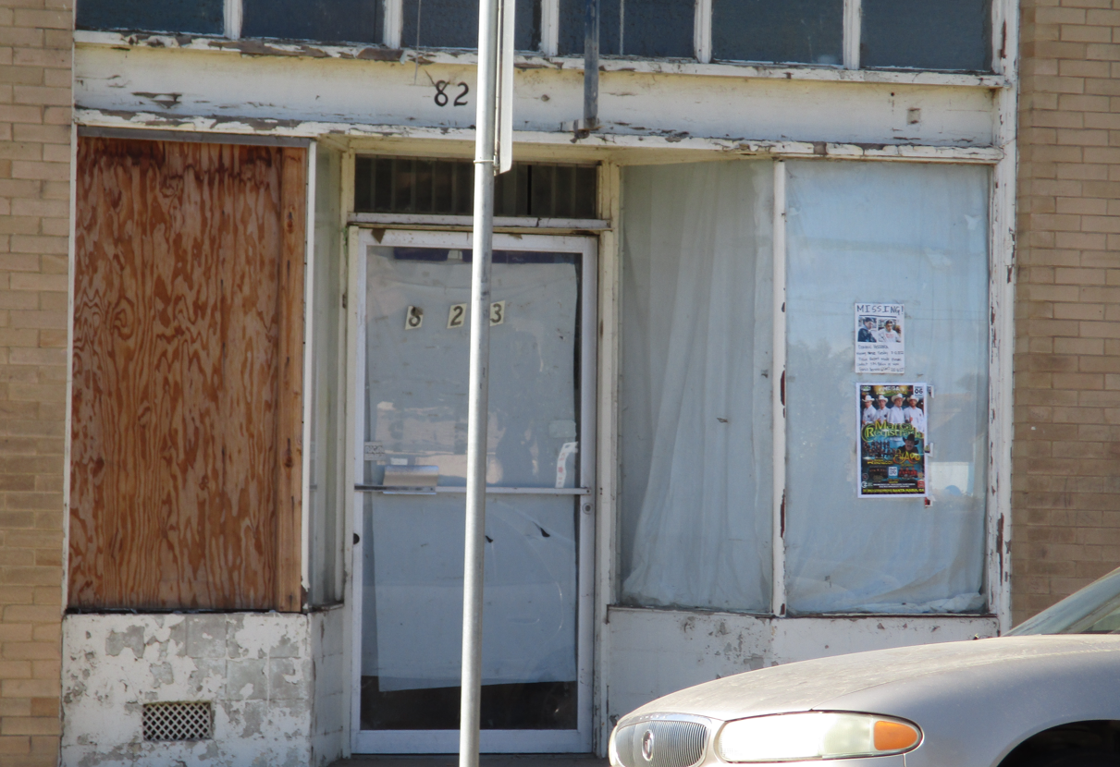
Renovate Exterior

Slide 18
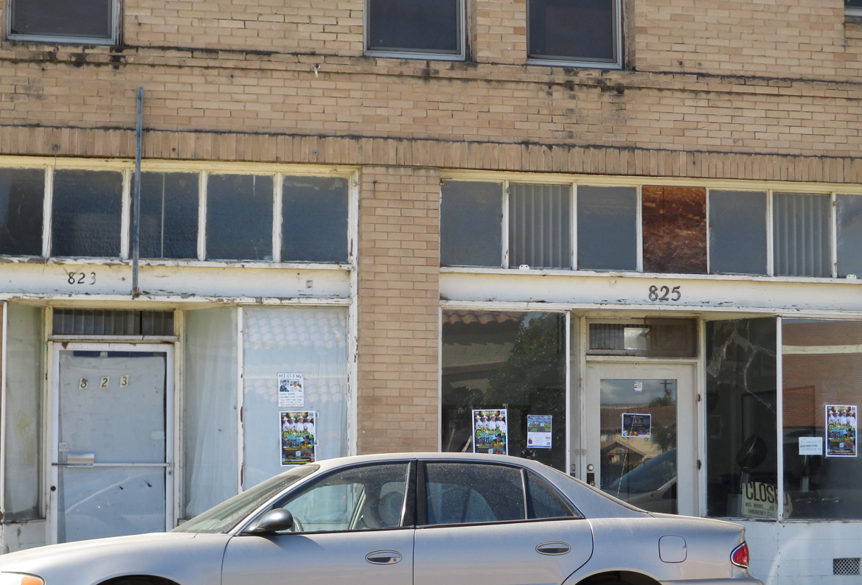
Clean-Renovate Exterior

Slide 19
Other Zoning Code Standards
Building Height: 35-feet max. (18.50.020)
Provided = 35-feet max.
Open Space Ground Floor: 100 SF (18.52.100)
Provided: 136 – 212 SF
Open Space – Upper Floor: 50 SF (18.52.110)
Provided: 54 SF - 110 SF
.

Slide 20
Other Zoning Code Standards
Landscape: 10% Min. (18.64.040(A)
Provided: 11.5% approx.
Walls/Fencing: Six-foot wall required northerly PL (18.52.110).
Provided: 6-foot wall will be provided in the building plans for Zoning Clearance.
Driveway (one-way): 12 feet wide or per Fire Dept. 18.60.140(D)(E)
Provided: 16-foot w/flat (rolled curb)

Slide 21
General Plan Conformance
More residential units in the downtown increases market demand for downtown businesses;
Efficient Development: Develop an underutilized (vacant) infill property where City infrastructure and services are already in place; and
The City will promote density bonuses and incentives…(LU-1.9 - from new 2021 General Plan)

Slide 22
CEQA Review
Class 32 Exemption
Applies to Infill Projects within City limits on less than five acres.
Site is adequately served by public utilities and municipal services; and
Site has no value as habitat for endangered spacies.

Slide 23
Recommendation
Adopt Resolution No. 2022-97 approving Conditional Use Permit 2022-027-CUP, Design Review 2022-030-DR and the CEQA Class 32 Exemption for for the
823 Guadalupe Apartment Project.

Slide 24
Questions?

