Slide 1
Guadalupe City Council
Conditional Use Permit and CEQA Clearance for Root One dispensary at
928 Guadalupe Street
Presented by
Bill Scott, Contract City Planner, Guadalupe City Planning Department
September 12, 2023

Slide 2
Project Description
Conditional Use Permit (2023-031-CUP) to allow:
Root One: A 2,200 square-foot retail cannabis dispensary.
Product Offered: Retail Sales and Delivery of recreational and medical cannabis products.
Location: 928 Guadalupe Street Downtown Mixed-Use zone.

Slide 3
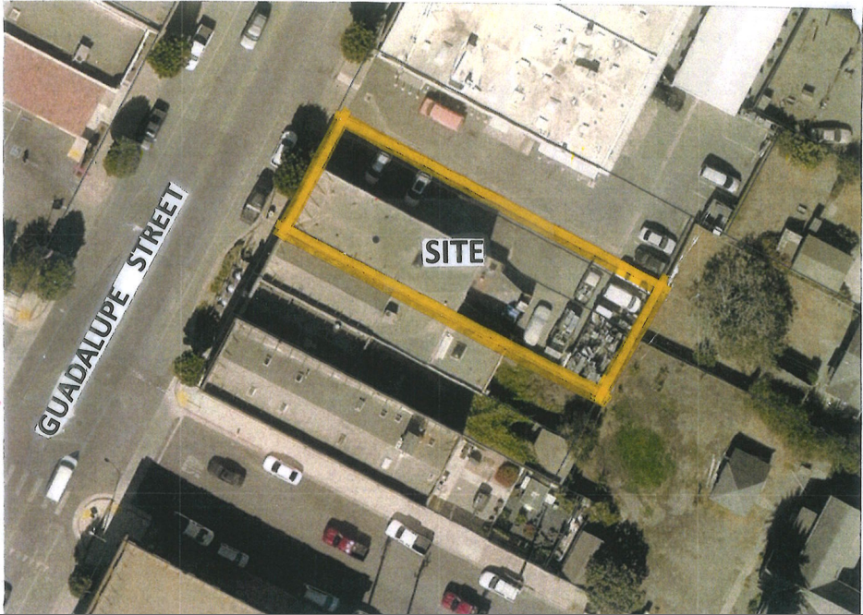
928 Guadalupe Street

Slide 4
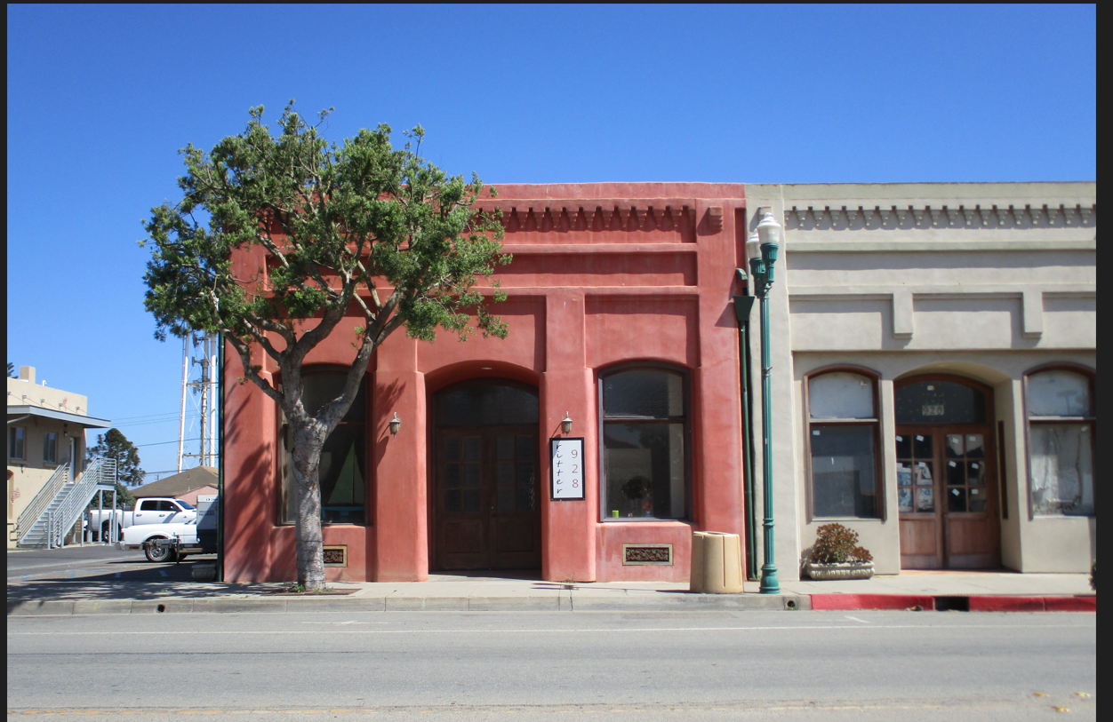
928 Guadalupe Street

Slide 5
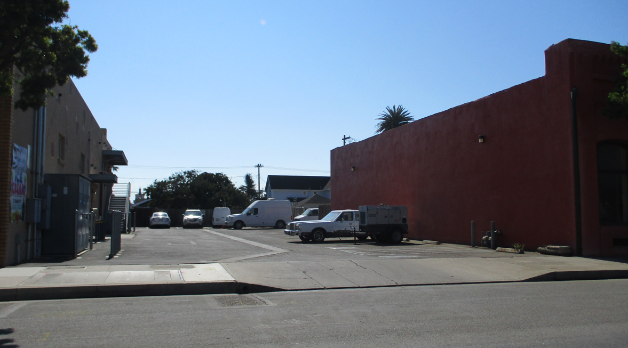
NORTH SIDE

Slide 6
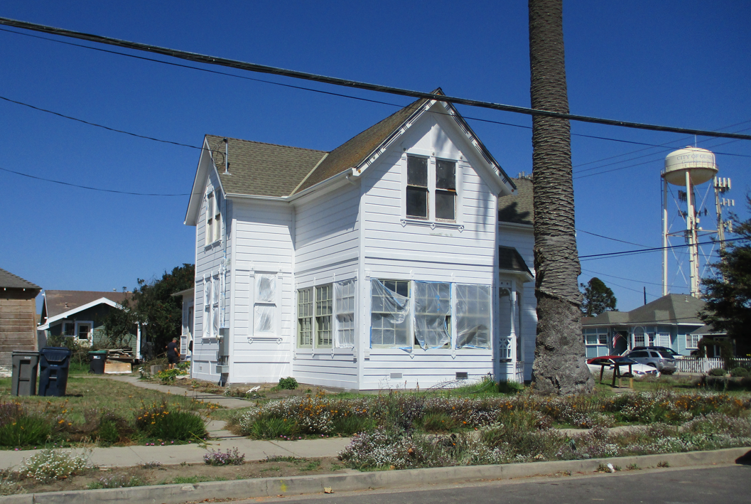
EAST

Slide 7
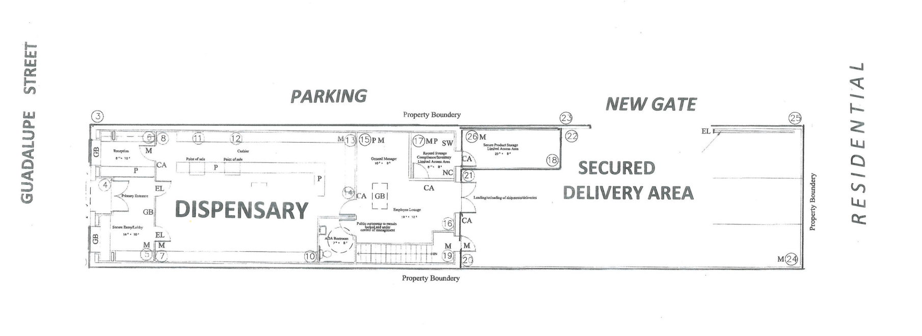
SITE/FLOOR PLAN

Slide 8
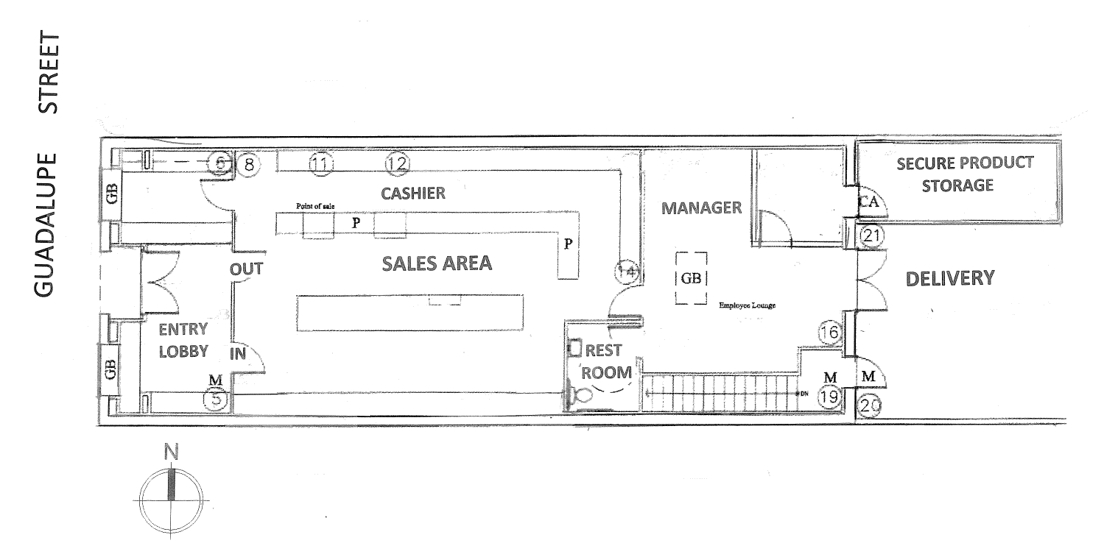
Security Plan/Floor Plan

Slide 9
Regulatory Requirements
State License:
State Business and Professions Code: Type- 10 State license for retail cannabis sales and delivery.
State (Department of Cannabis Control) will not issue a state license until local jurisdiction approves the dispensary use (i.e., a City Conditional Use Permit).

Slide 10
Approvals needed to Operate
(GMC 9.22) City Requirements:
- State Cannabis License; and
- City Cannabis Business Permit.
Before a City Cannabis Business Permit is issued, approval requires:
A Conditional Use Permit;
A Community Benefit Agreement;
A Building Permit.

Slide 11
Conditional Use Permit
CUP 2023-031-CUP Considered:
Neighborhood compatibility;
Established cannabis dispensary operation standards (Consultant);
Municipal Code conformance:
- Title 9 – Chapter 9.22 (Cannabis
Ordinance); and
- Title 18 – (Zoning).

Slide 12
Neighborhood Compatibility
Among Some Conditions of Approval are:
Orderly Customer Flow. One entrance – one exit - Customer identification and monitoring plan.
No Noise. Limited outdoor activity. Loitering and on premises use prohibited.
Security Personnel on duty during all hours of operation.
Shielded outdoor security lighting.
Parking.

Slide 13
Consultant’s Standards
Consultant Conditions require a Security Plan including:
Camera Plan.
Alarm Plan.
Product Delivery and Path of Travel specifications.
Product Storage standards.
Door and Window Security Plan.

Slide 14
Municipal Code Compliance
Some of the requirements under Municipal Code Chapter 9.22 (Cannabis Ordinance):
A Sensitive Land Use Evaluation.
Coordination and Reporting to the City.
Security Personnel selection criteria.
Odor control standards.
Waste Disposal standards.
A Community Benefit Agreement;
A Community Contact Person.

Slide 15
Zoning Ordinance
Among some of the Zoning Code Standards:
Parking: Twelve off-street parking spaces;
Storage: Company Vehicle Storage off-street;
Design Review: Site and Building improvements compatible with surroundings.

Slide 16
Adjacent Buildings

Slide 17
General Plan Conformance
Economic Development Policy DE-5:
The City will encourage new types of industrial and commercial uses to to diversify the City’s economic base.
The project would expand the variety of retail goods and services offered in the City and potentially draw new retail consumers to downtown Guadalupe.

Slide 18
Conclusion
In Summary:
The facility will meet the standards of Municipal Code Chapter 9.22 and the Zoning Ordinance.
The facility incorporates industry standards as prescribed by the expert cannabis consultants.
The Root One dispensary is conditioned to be harmonious with the neighborhood.
The facility will conform to state law.
The retail dispensary will support Econocmic Development objectives of the City’s General Plan.

Slide 19
CEQA Review
Class 1 (Existing Facilities) Exemption:
Reuse of an existing building where no expansion takes place.

Slide 20
Recommendation
Adopt Resolution No. 2023-74 approving:
Conditional Use Permit 2023-031-CUP; and the CEQA Exemption for the SLOCAL Root One commercial cannabis dispensary at 928 Guadalupe Street.

Slide 21
Questions?

